Slide 1


MAGLAJ
MUNICIPALITY OF MAGLAJ

Slide 2
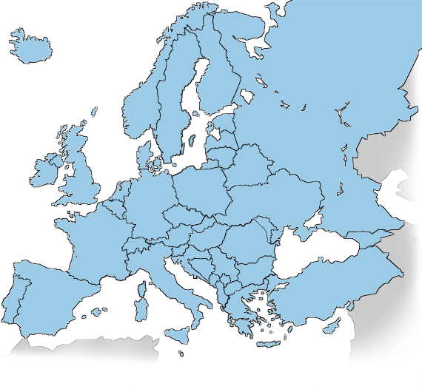
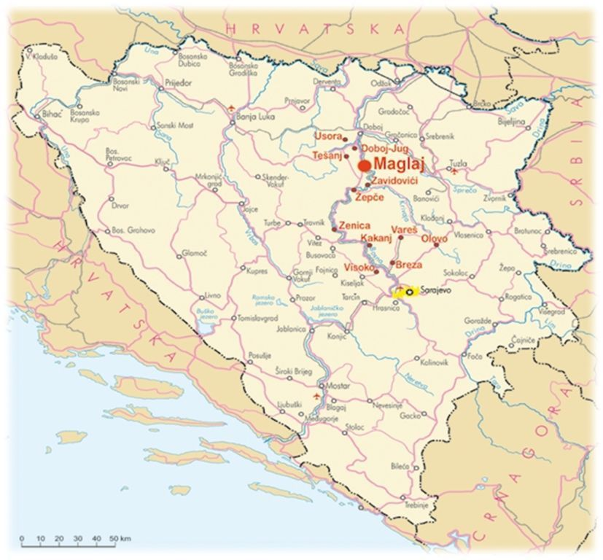
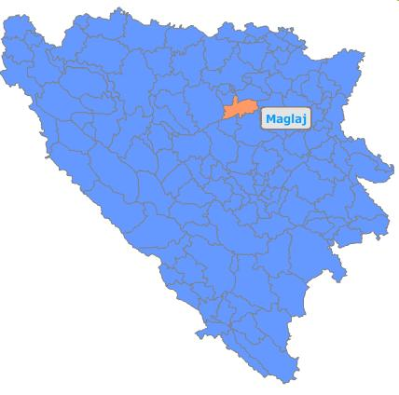
Maglaj
Maglaj - Zenica-Doboj Canton
Population – 23’126
125 km north of Sarajevo
290 km - Zagreb, 300 km - Belgrade
highway put M-17 – future corridor Vc
Railroad Bosanski Šamac-Sarajevo-Ploče
Airports - Tuzla (88 km) and Sarajevo (125 km)

Slide 3
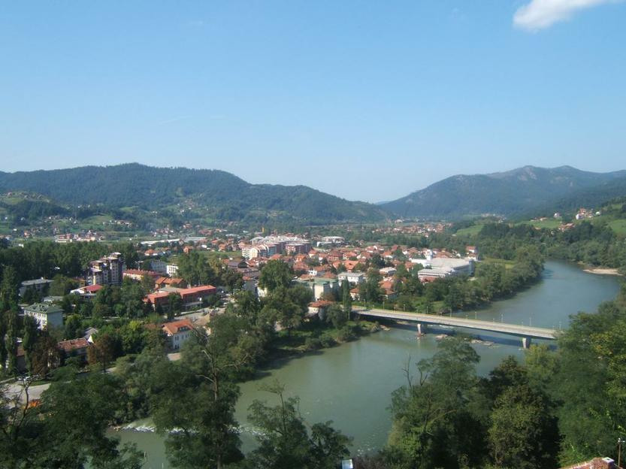
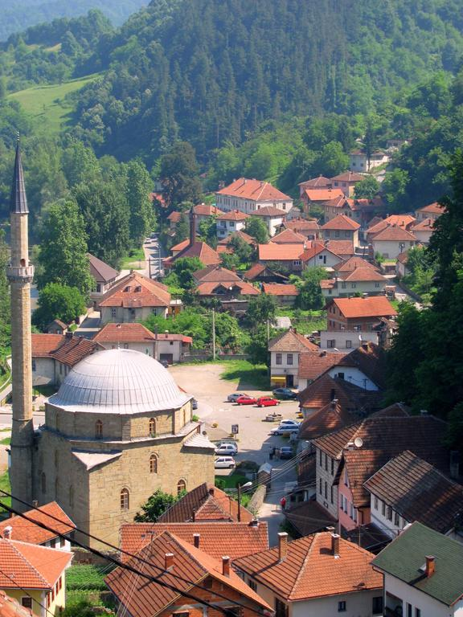
Old & New Town

Slide 4
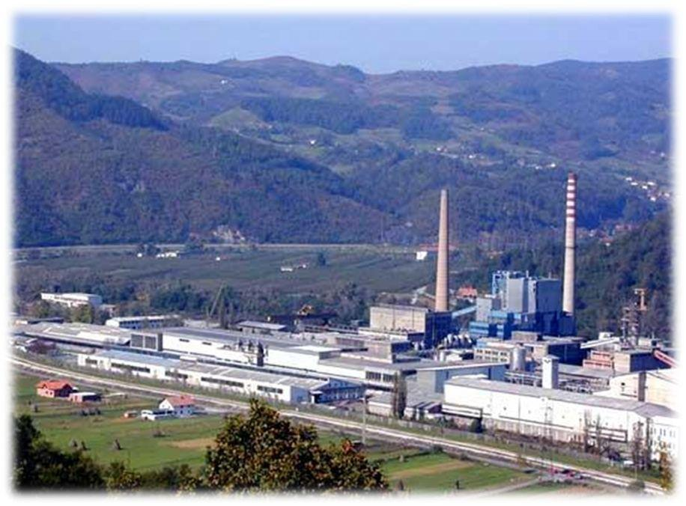

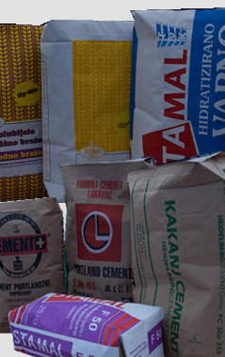
Business
Prior to the war the cornerstone of our industry was the company “Natron” as the biggest producer of cellulose in the Balkans
Today Natron is privatized by the Turkish company “Kastamonu Entegre” with an investment of over 100 million € and employs 900 people

Slide 5
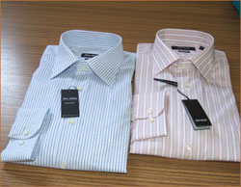
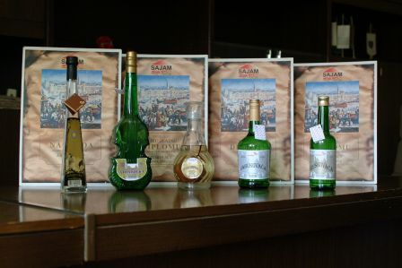

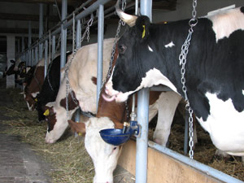
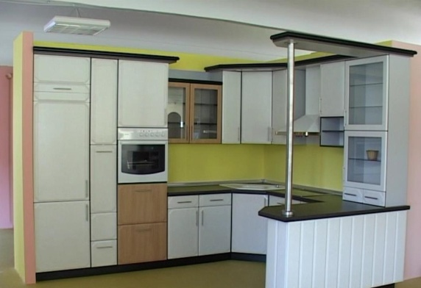
Maglaj has about 897 registered businesses of which 369 are crafts and shops of different services:
Textile Industry
Furniture Industry
Metal Industry
Woodwork Industry
Production of milk and milk products
Construction
Transport
Services and others

Slide 6
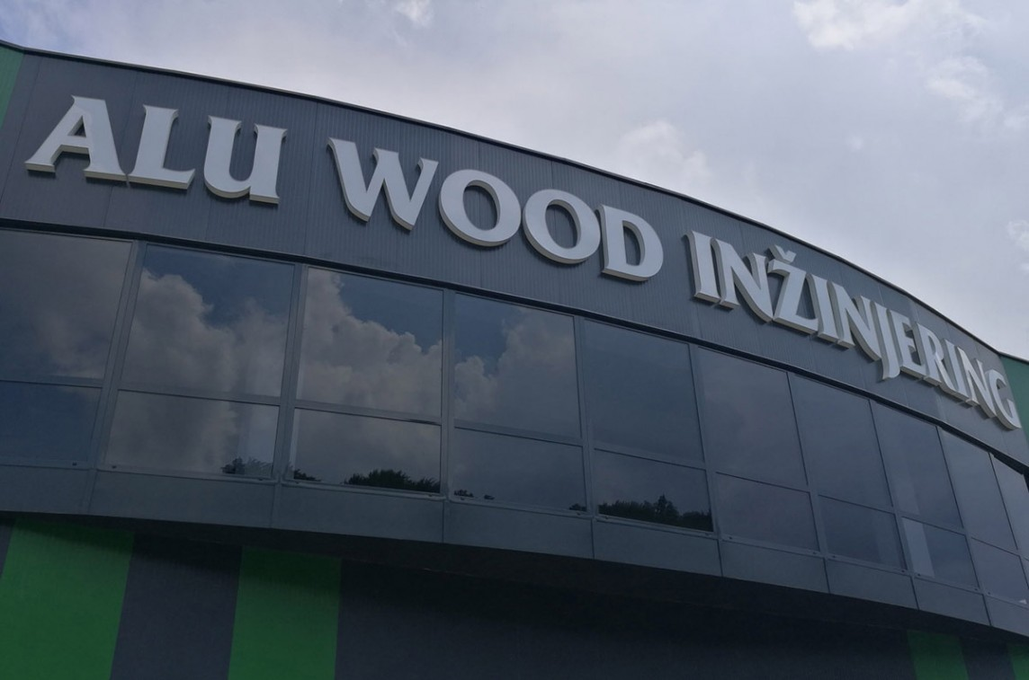
Alu Wood Inženjering d.o.o. Maglaj
With years of experience in the construction field it has an active role in the reconstruction and construction of private and public buildings, as well as the production of all kinds of woodwork.

Slide 7
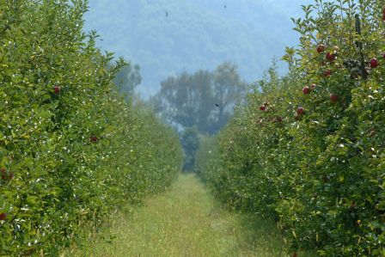
D.D. Mapex Maglaj
This company was founded in 1987 and is active in production, trade and
catering. Production takes place on two locations, Omerdino Polje,
where apples and pear are grown on 20 ha
Mapex Schnaps
Plantation of Apples and Pears

Slide 8
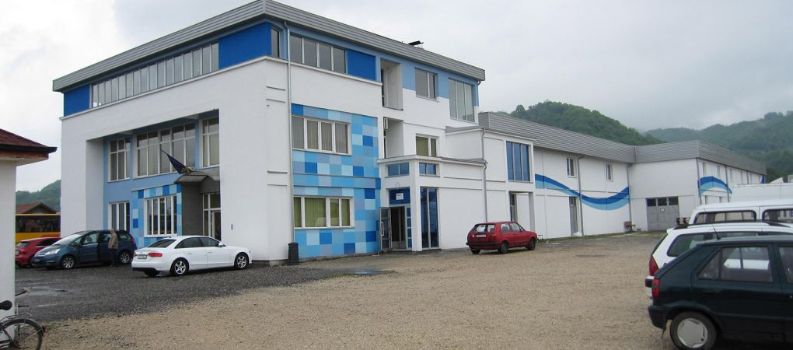
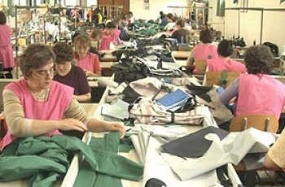
Bontex d.o.o. Maglaj
Bontex d.o.o. – produces shirts and other clothing mainly for markets in Switzerland. The company employs around 250 people in a 3’000m2 facility.

Slide 9
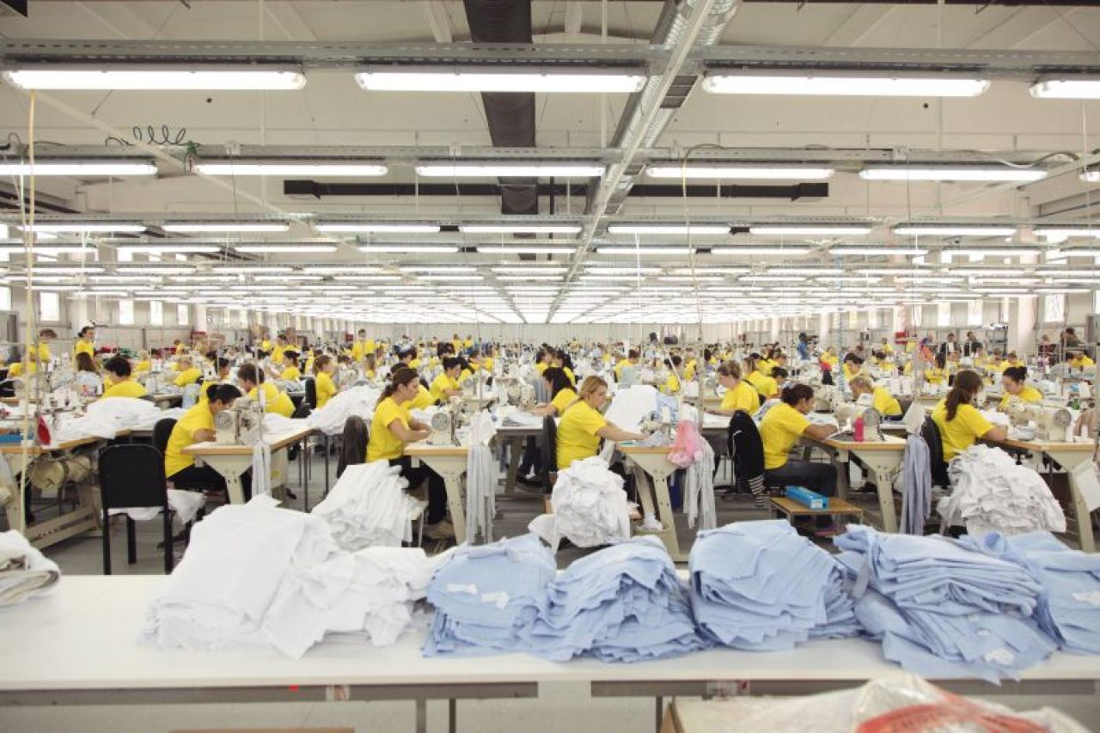
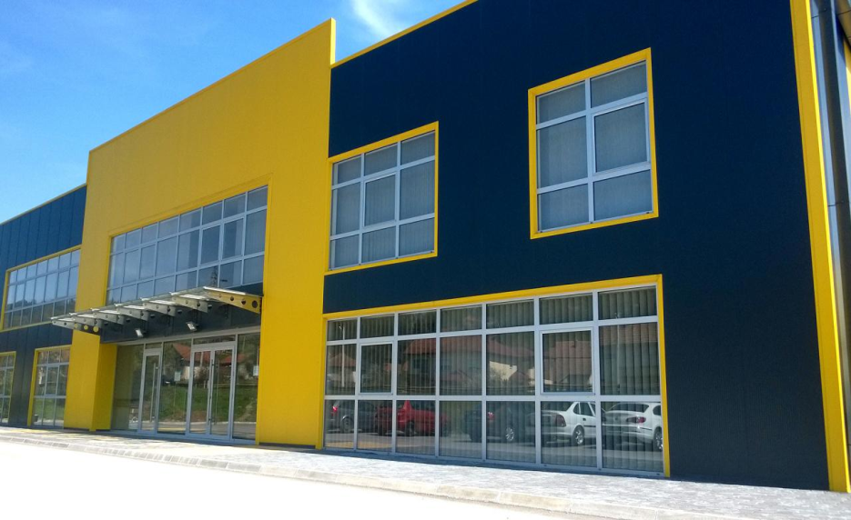
HM promet d.o.o. Maglaj
The company HM promet d.o.o. Maglaj produces protection clothing
mainly for the German market and employs around 400 people in a
5’000m2 facility.
It has over 1700 models available and found buyers like Mercedes
Benz, BMW, Nissan, Kia, Maggi and others.

Slide 10

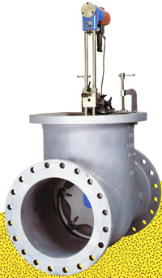
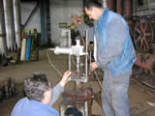
Efco nat d.o.o. Maglaj
Efco nat d.o.o. Maglaj was founded in 1998 as a joint venture with the company EFCO Maschinenbau GmbH, Dueren Germany.
Efco nat – provides specialized services in the examination and repair of valves and armature in:
-thermal power plants
-hydro power plants
-industrial heating power plants
-refineries
-chemical industry
-paper-cellulose industry

Slide 11
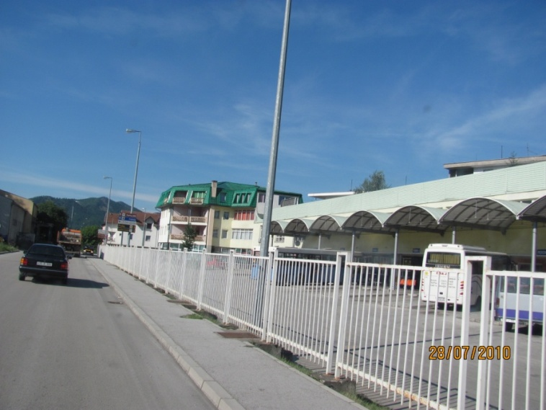
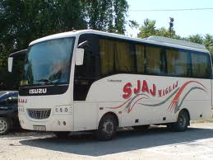
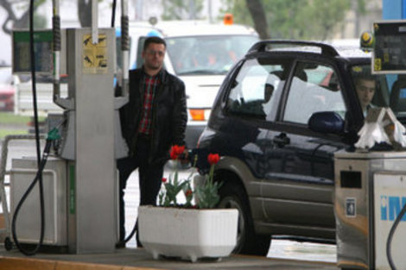
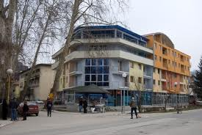
Sjaj d.o.o. Maglaj
A company with a wide range of activities:
-Bus station
-Pension
-Gas stationBenzinska pumpa
-Technical inspection of vehicles

Slide 12
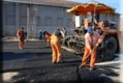
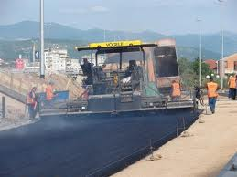
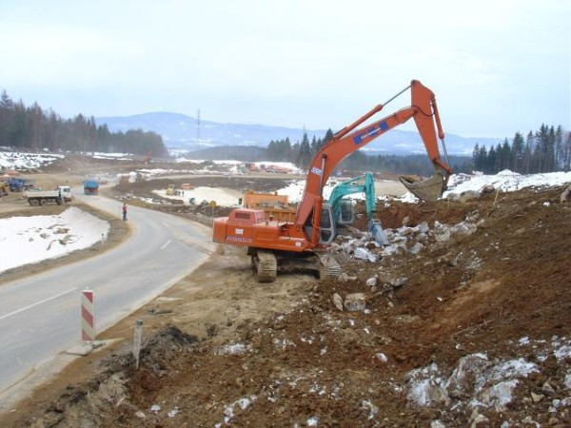
Hajdic d.o.o. Maglaj
Hajdić d.o.o. a highly experienced company in road construction with years in the field and an impressive résumé

Slide 13
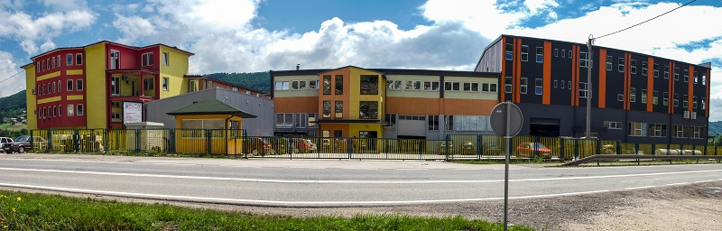
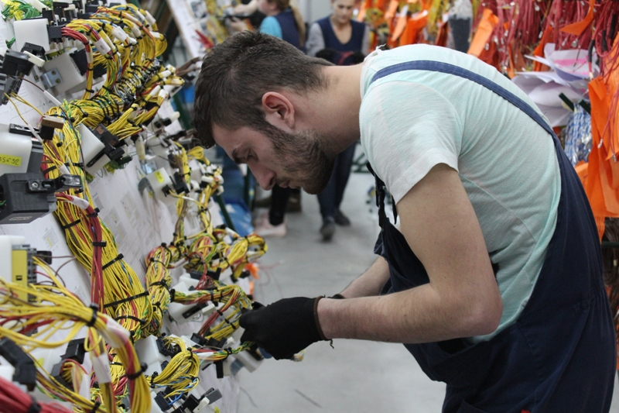
Excel-Assembliesss BH d.o.o. Maglaj
A British company specialized in the production of different kinds of cables for the aviation and defense industry. Currently they employ around 450 people.

Slide 14
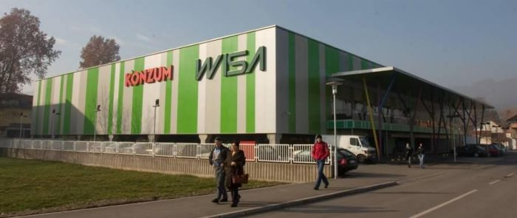
Malls
Wisa shopping center
Konzum hyper market
YIMOR
Eurocentar 1 2 & 3
Bingo shopping center

Slide 15
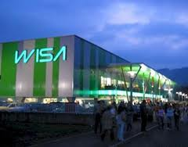
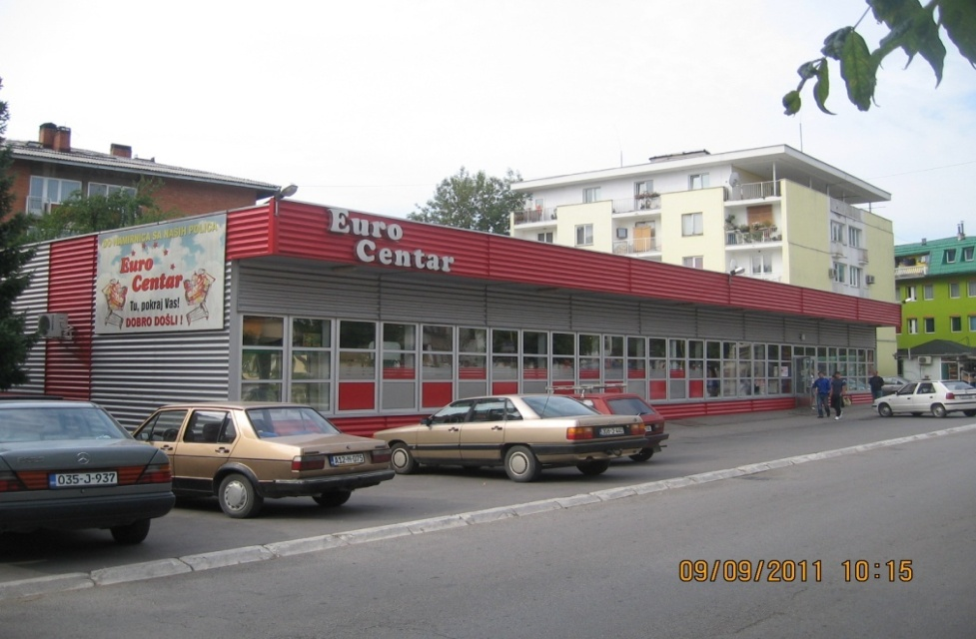
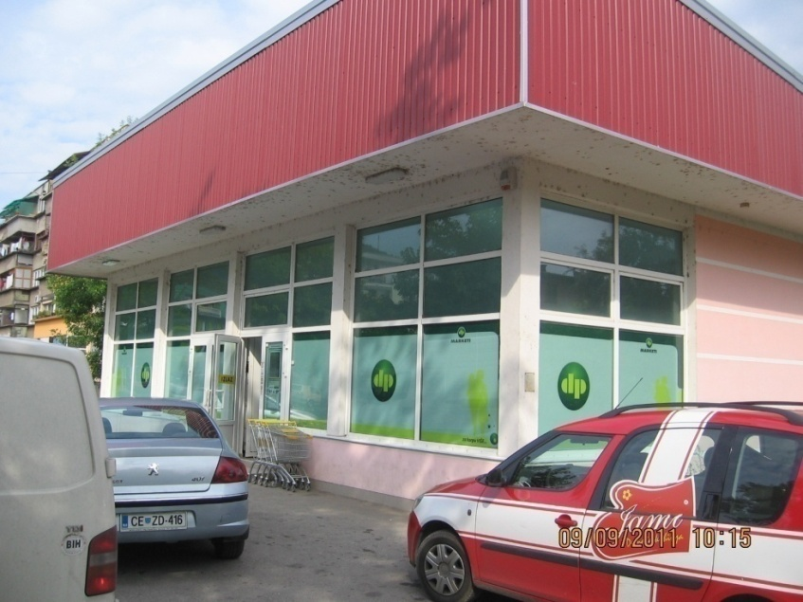
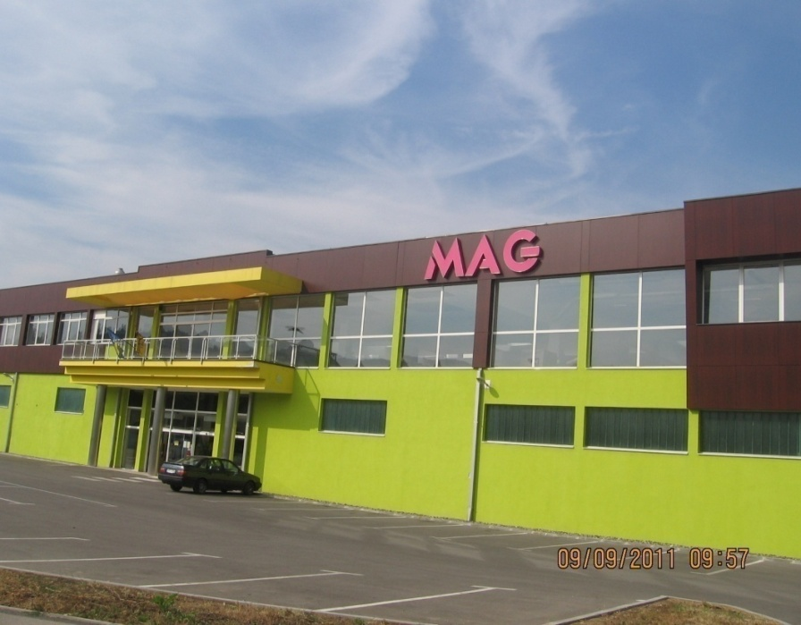
Eurocentar 1
WISA shopping centar
Merkator
YIMOR

Slide 16
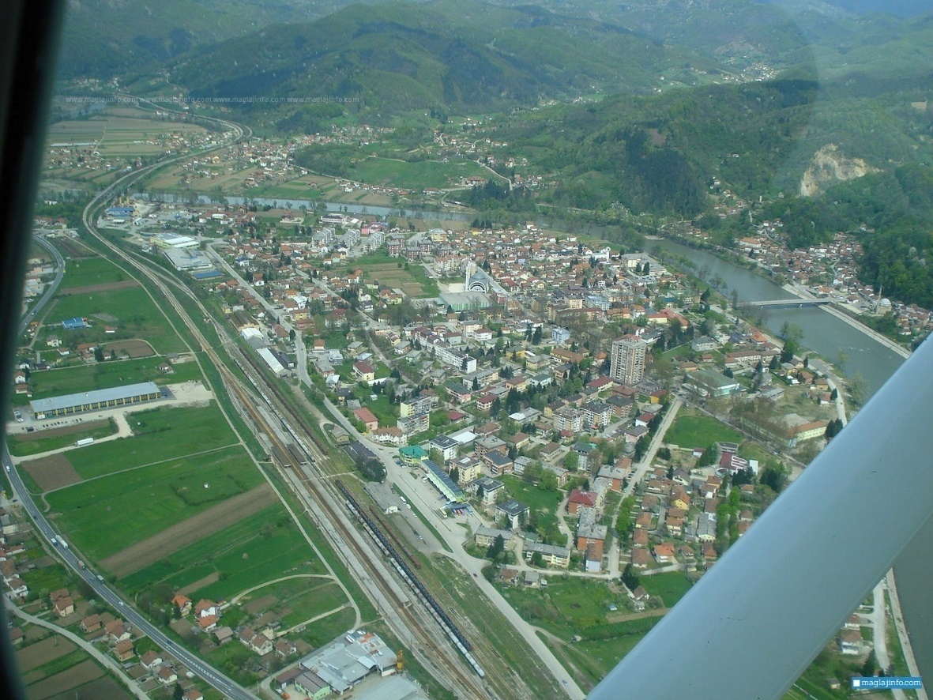
Industrial Zones
Misurići
Liješnica
Novi Šeher

Slide 17

INVEST IN MAGLAJ
INDIVIDUAL APPROACH
SERVICES OF A LOCAL COMMUNITY
BUSINESS FRIENDLY ENVIRONMENT
SATISFACTION OF CURRENT INVESTORS
GEO LOCATION

Slide 18
AGRICULTURE

Slide 19
AGRICULTURE
Maglaj has 3 registered agricultural co-operatives.
1. ZZ “Milk – Maglajka“ Maglaj
2. ZZ “Kula” Strupina bb, Novi Šeher, Maglaj
3. ZZ “Agrar-Šeher” Novi Šeher, Maglaj
And 12 agricultural associations of producers:
1. UG “Bistrica” Ravna-Oruče
2. UG “Jedinstvo” Bočinja
3. UG “Cow-How” Čobe
4. UG “Poljoprivrednik” Novi Šeher
5. UG “Pčelar” Maglaj
6. UG “Melisa” Bakotić
7. UG“Bijela Ploča“ Bijela Ploča, Maglaj
8. UG “Šampinjon” Donji Ulišnjak, Maglaj
9. UG „Agro-Liješnica“ Liješnica
10. UG „Kopice“ Kopice
11. UG „Agro-Kopice“ Kopice
12. Agro-Eko težak“ Ravna

Slide 20

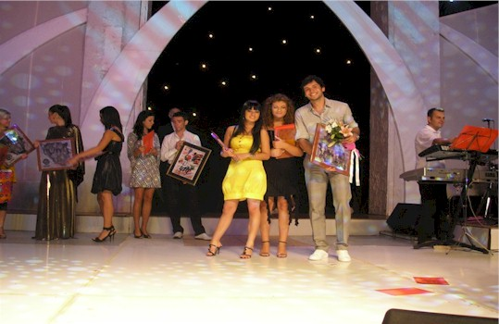
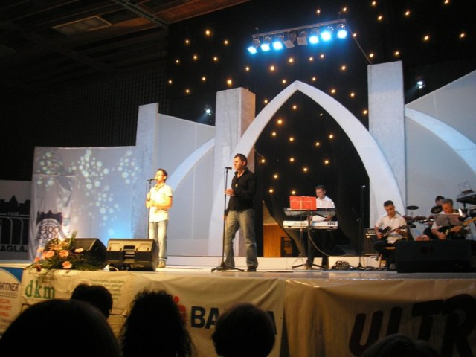
CULTURE
“Studentsko ljeto” is a cultural manifestation which is held for already 46 years and traditionally starts with a parade and fireworks. It lasts for two months and entails events of peatry, art galleries ant other cultural content.

Slide 21
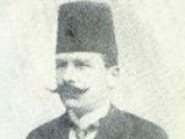
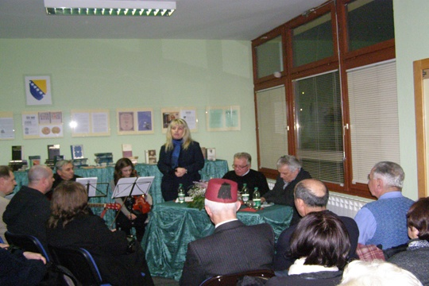
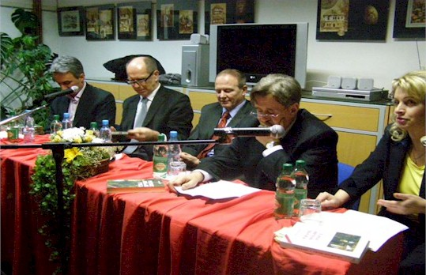
Mulabdic days of culture is a manifestation organized by our library and entirely dedicated to this master of literature
Edhem Mulabdić 1862. - 1954. born in Maglaj, author of the first Bosnian novel which left a everlasting footprint

Slide 22
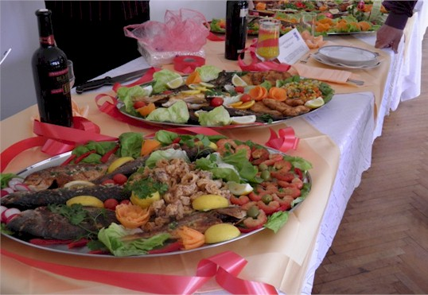
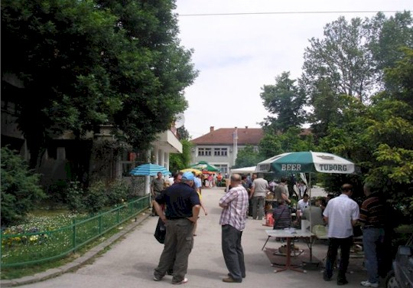
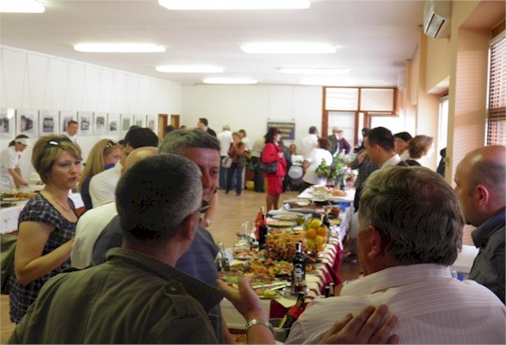
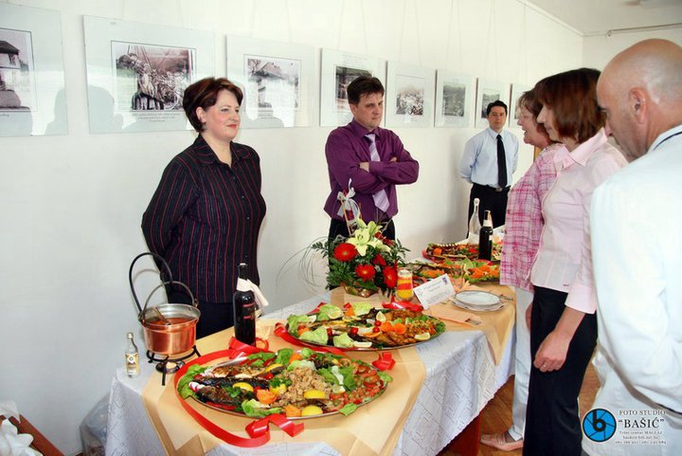
With support by the local government it has become an annual culinary tradition for local connoiseurs
Maglaj fest

Slide 23
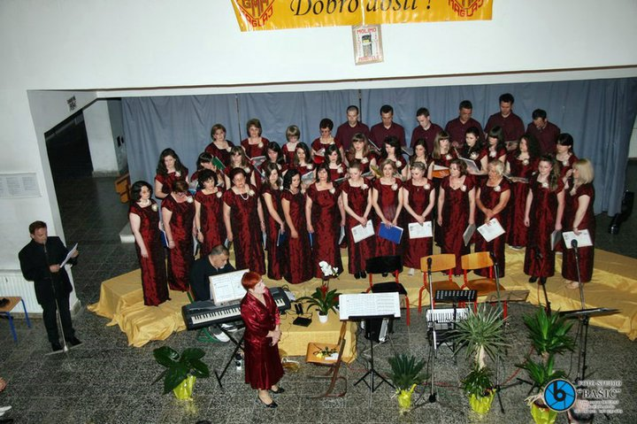
Choir Maglaj
Established in 1997, the choir consists of 40 female and 10 male vocalists, with a repertoir of over 400 compositions in 11 different languages.

Slide 24
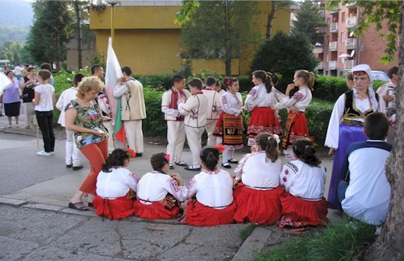
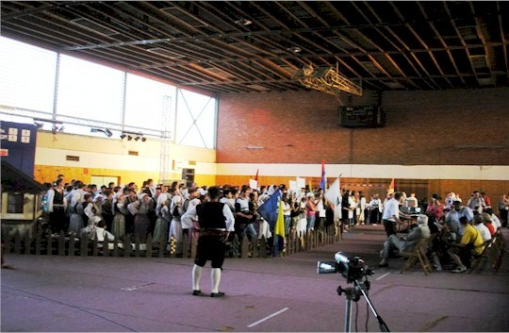
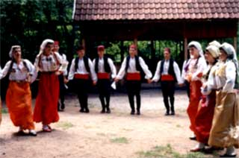
Folklore Ensamble Maglaj
Has achieved numerous results in the promotion of bosnian culture throught the international festival „Kolo na bosanskom ćilimu“, which has been declared as a project of national interest by the Ministry of Culture FBiH.

Slide 25
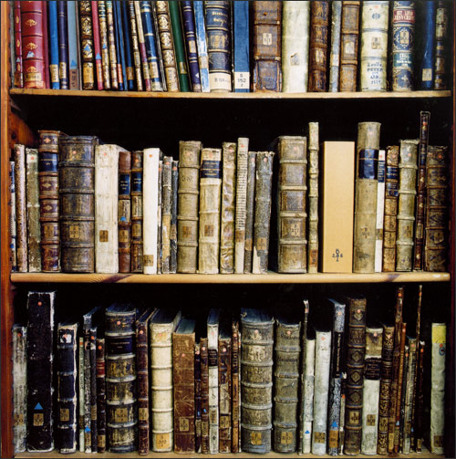
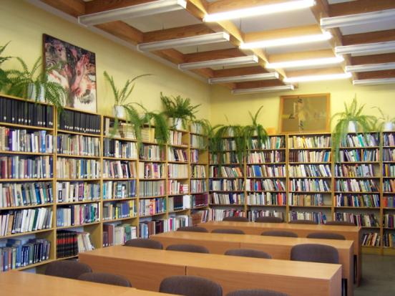
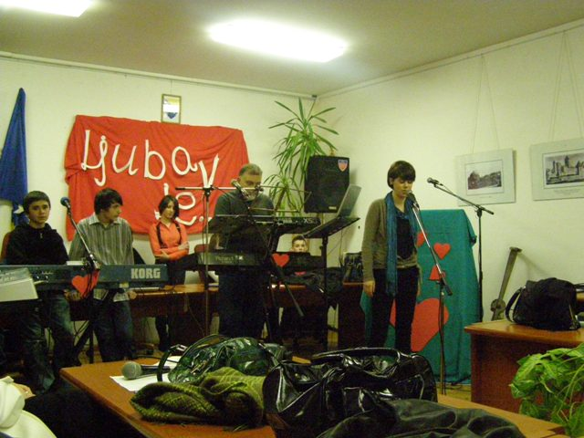
Library Maglaj
Officialy exists since 1958 with over 30‘000 pieces, which makes it one of the best equipped libraries in BiH.

Slide 26



Culture Centre”Edhem Mulabdic”
Is the main organizer of cultural, sport and educational events, as well as fairs in Maglaj.

Slide 27
Sport
Maglaj has 19 active sports clubs
1. FC “Natron”
2. FC “Novi Šeher”
3. FC “Vis Sim-bau” Kosova
4. FC „Moševac“
5. HC“Maglaj”
6. Volleyball Club“Maglaj”
7. Basketball Club“Maglaj”
8. Kayak Club“Natron”
9.Kayak-Canu Club “Maglaj
10. Korfbal Club “Maglaj

Slide 28


11. Fishing Association “Bosna”
12. Hiking Association“Smajlovac”
13. Hunting Association“Soko”
14. Union for paralympic sport
15. Paralympic Volleyball Club
16. Association of Gym Teachers
17. Sport Association of the municipality of Maglaj
18. Bowling Club“Maglaj”
19. Karate Club “Empi”

Slide 29
CIVIL SOCIETY ORGANIZATIONS
1. KUD »Gradski folklorni ansambl»
2. «Gradski mješoviti hor» Maglaj,
3. HKUD «Gromovnik» Novi Šeher
4. Kulturno-umjetničko društvo “Novi Šeher”
5. Udruženje žena “Cicmanka”, Novi Šeher
6. Udruženje žena “Maglajka”
7. Udruženje gradjana ”Umero”,
8. Udruženje gradjana penzionera Maglaj
9. Udruženje građana ”Merhamet”,
10. Općinska organizacija ”Crveni krst”
11. Udruženje građana “Crveni polumjesec”
12. Centar za omladinski rad i neformalno obrazovanje “CORNO”
13. BalcanAkcija
14. UG Udruženje inovatora Maglaj
15. UG “Centar”, Maglaj
16. UG “Soko”, Maglaj
17. UG “Bistro” Maglaj
18.Udruženje planinara
19. UG “AirSoft club” Maglaj
20. Fitnes klub
21. Udruženje Invalida rada
22. Udruženje mladih «Aktivista»
23. Udruženje „Antifašista i boraca NOR-a“
24. Udruženje „Umjetnika i poštavalaca umjetnosti“
25. Planinarsko-ekološko i sportsko rekreacijsko društvo „OAZA MIRA“ Galovac,
26. Asocijacija roditelja i nastavnika OŠ Novi Šeher
27.Udruženje samostalnih privrednika općine Maglaj
28. ZZ ''Milk-Maglajka'' Liješnica, Maglaj,
29. ZZ ''Magplas'' Bočinja-Bakotić, Maglaj
30. ZZ ''Agrar-Šeher'' Novi Šeher, Maglaj
32. UG ''Bistrica'' Ravna-Oruče
32.UG ''Jedinstvo'' Bočinja
33. UG ''Cow-how'' Čobe
34. UG''Poljoprivrednik'' Novi Šeher
35. UG''Pčelar'' Maglaj
36. UG''Melisa'' Bakotić – Ulišnjak
37. UG''Šampinjon'' D. Ulišnjak, Maglaj
38. Asocijacija udruženja poljoprivrednika ''Farmer'' Maglaj konkretno vezani za proizvodnju mlijeka

Slide 30



LANDMARKS
Gradina - tvrđava nastala u 13. vijeku, kasnije dograđena u vrijeme turske vladavine.

Slide 31




RELIGION
“Vali Recep Yazicioglu“ Mosque
Sanctuary Leopold Mandić
Jusuf-pašina “Kuršumlija” Mosque
Orthodox Church St. Ilije Proroka

Slide 32



Jusuf-pašina “”Kuršumlija” Mosque
Counts as on of the most beautiful monuments of the Ottoman period in BiH. Raised by je Jusuf-paša Budimlija in 1560 the mosque gets its name from the Turkish word kuršum which means lead.

Slide 33



1875– Uzeirbegov lodge was built by a descandant of Salih-beg Uzeirbegović

Slide 34


Maglaj Spheres
A monument raised in 1878 in honour of fallen Austro-Hungarian soldiers

Slide 35

At the base of mountain Ozren, according to estimates the cave is 2500 meters long.
CAVE MEGARA

Slide 36





TOWN PICTURES

Slide 37





Slide 38







NEW BUILDINGS

Slide 39
WELCOME TO MAGLAJ !

